Slide 1
Welcome to
The Virtual
Wolfpack!

Slide 2
Student Development and Activities Updates
Get involved in Student Life at WCC!
WINTER 2021 VIRTUAL PROGRAMMING
Student Activities
Student Organizations
WCC Sports
Washtenaw Voice
Phi Theta Kappa

Slide 3
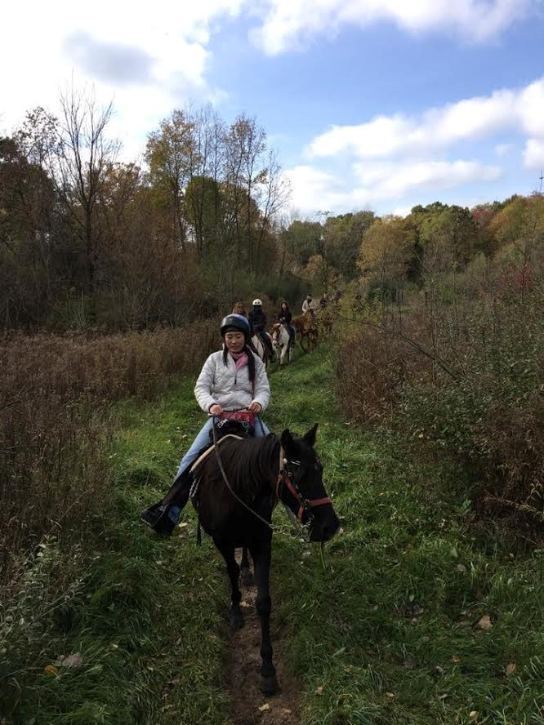
Student Activities
Winter 2021 Events:
MLK Celebration
Virtual Welcome Week
Virtual Escape Room
Bingo
Global Discussion Series
Murder Mystery
Virtual Painting
To Learn More About Student Activities:
Email Rachel Barsch rbarsch@wccnet.edu
Notes:
Participated in a Virtual Marathon
Triva
Scavenger Hunt
Financial Literacy Bootcamp
Digital Talent Show
Halloween Contest
Guest Speakers
Personality Assessment Event
Weekly Virtual Hang Outs

Slide 4
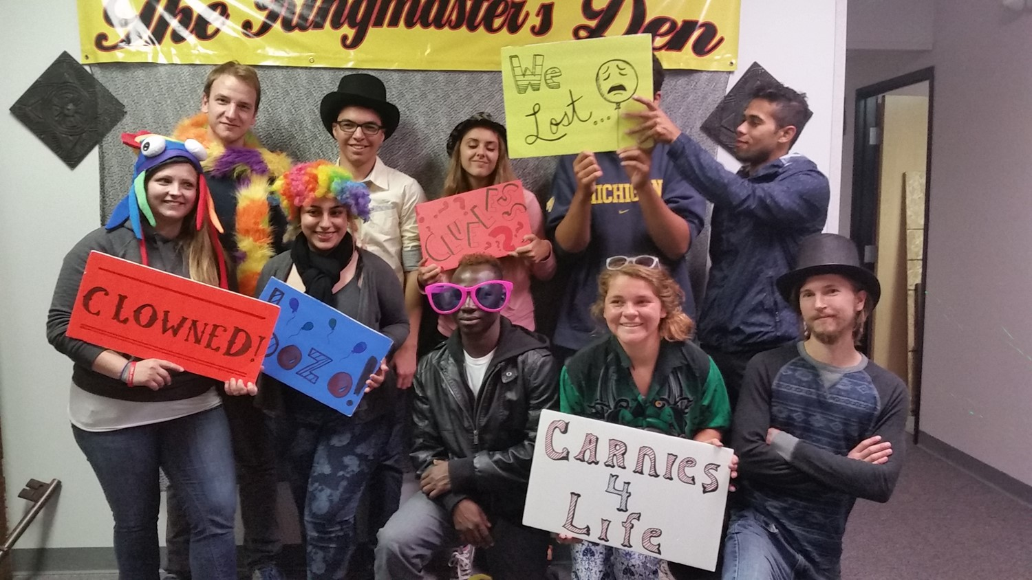
Student Organizations
Winter 2021 Events:
Join or start a student club.
Virtual Leadership Summit
Club Socials (Trivia, Sketching, Fitness, etc...)
Join Phi Theta Kappa
Honors in Action Project
Club Leader Awards
To Learn More About Student Activities:
Email Veronica Boissoneau vboissoneau@wccnet.edu
Notes:
Club Fair Day
Stress Management for Club Leaders
Finding Your Why
Virtual Yoga
Club Officer Training
Clubs Ran Virtually via Google Hangouts

Slide 5
WCC Sports
Winter 2021 Events:
Monthly eSports tournaments
Virtual Cross Country and Competitive Dance
Virtual brackets, fitness competitions, and more…
Limited In-Person Club Sports
To Learn More About Student Activities:
Matt Lucas mflucas@wccnet.edu
Notes:
In Fall – Weekly Trainer Led Workouts
In Fall – Weekly Golf
Virtual Bracket Contests (Athletes and Movies)
Trick Shot Challenge
Athlete Hangouts
Virtual Speakers
A Coach and UM Development Professional Discussed Negotiations
The Director of Education at the Detroit Lions talks about purpose
TODAY – Assistant Coach of the Philadelphia Eagles discusses leadership
ESports
Smash Brothers
Rocket League
Call of Duty

Slide 6
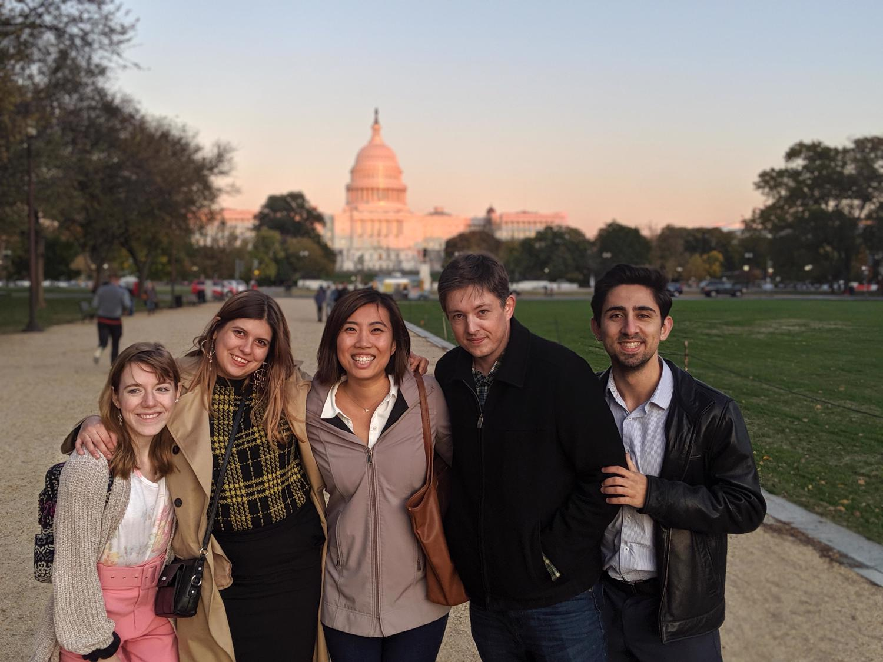
The Washtenaw Voice
Winter 2021 Events:
Web publication on washtenawvoice.com
Social media promotion.
Virtual Journalist Education Summit
LOOKING FOR PAID CONTRIBUTORS!
To Learn More About Student Activities:
Email Judy McGovern jumcgovern@wccnet.edu
Notes:
Website, social media, video weekly
Journalist Training
Attended Virtual Conference
Guest Speaker – Detroit FreePress to talk about how to cover Covid
Two awards:
Honorable Mention for Reporter of the Year
Awarded by the Associated Collegiate Press
Fall 2020
Second Place for Best Written Special Section of More Than Four Pages
Awarded by the College Media Association
Fall 2020

Slide 7
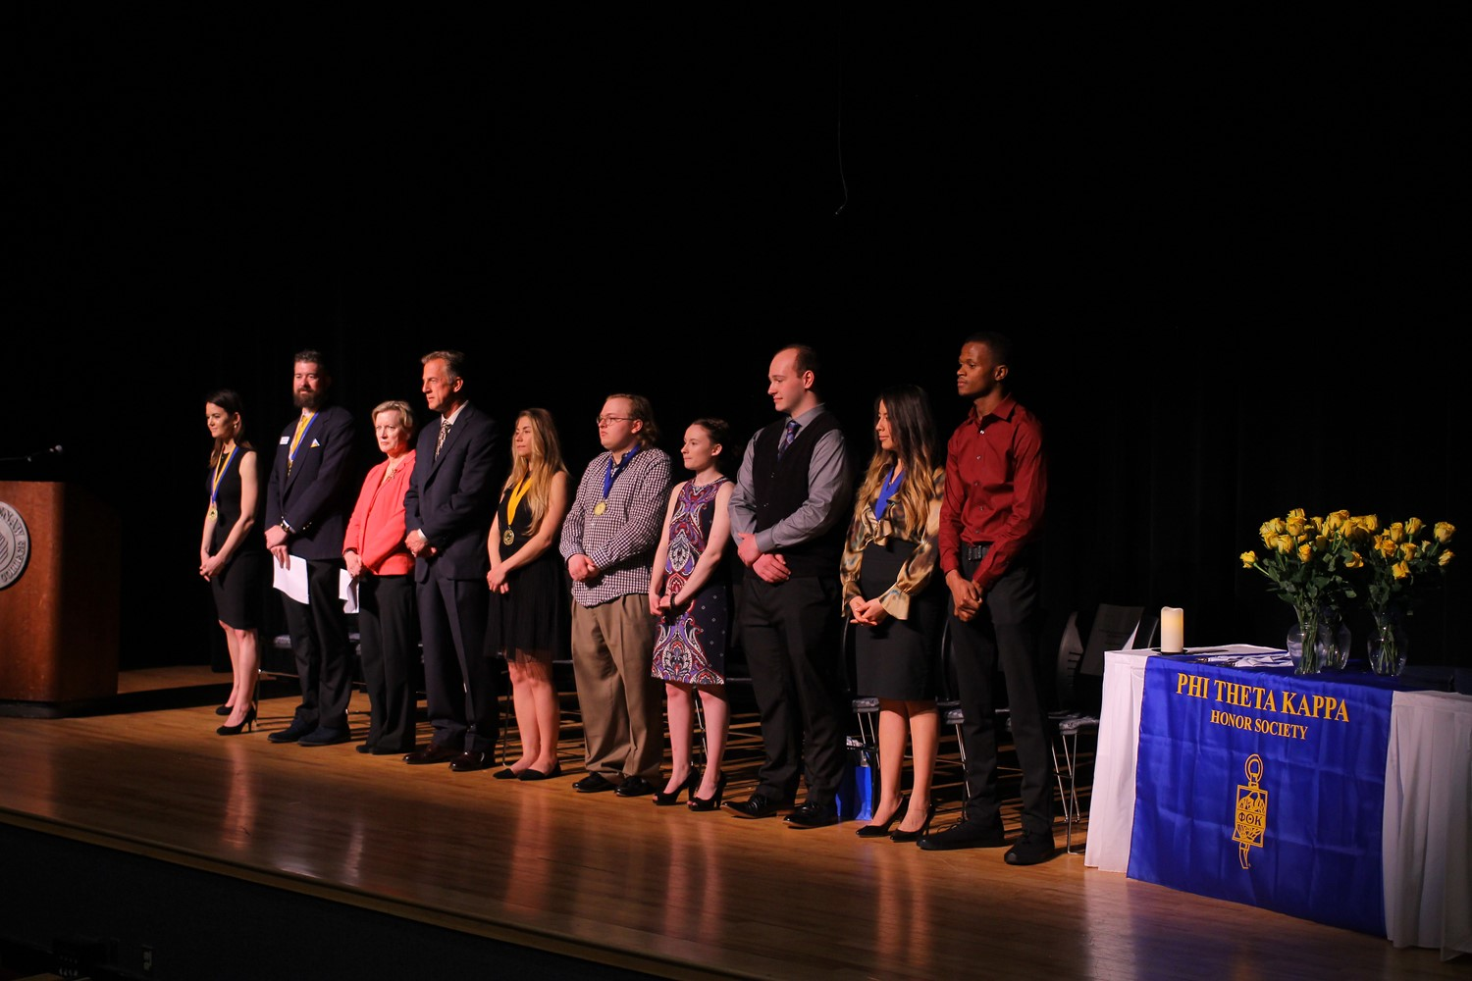
Phi Theta Kappa
Winter 2021 Events:
Weekly Meetings
Virtual Leadership Conference
Honors in Action Research Project
Commit to Complete Event
Virtual Social Events
To Learn More About Phi Theta Kappa:
Email Veronica Boissoneau vboissoneau@wccnet.edu
Notes:
Virtual Meetings
Pen Pal Program with a local long-term senior care home
Human Book Diversity Event
Commit to Complete
Virtual Induction Ceremony

Slide 8
Introducing…

Slide 9
NEW:
THE WCC
EXPERIENCE
Extra-Curricular & Co-Curricular Pathways for Students at WCC
WITHIN CAMPUS CONNECT: http://tinyw.cc/sda
Notes:
Today, I’m excited to introduce...
The WCC Wolfpack Experience
Pathways for students at WCC.
(NEXT)

Slide 10
Definition of a Pathway:
Pathways live within our Campus Connect system: http://tinyw.cc/sda
Pathways live within WCC’s Campus Connect system: http://tinyw.cc/sda
A pathway is a series of digital “Checklists” called “Domains” that guide students through experiences within extra- or co-curricular programs.
DOMAIN 1:
Item 1
Item 2
Item 3
Item 4
Item 5
DOMAIN 2:
Item 1
Item 2
Item 3
Item 4
Item 5
DOMAIN 3:
Item 1
Item 2
Item 3
Item 4
Item 5
DOMAIN 4:
Item 1
Item 2
Item 3
Item 4
Item 5
DOMAIN 5:
Item 1
Item 2
Item 3
Item 4
Item 5
DOMAIN 6:
Item 1
Item 2
Item 3
Item 4
Item 5
Pathways give students guidance, and allow the pathway administrator to keep track of each student’s progress and communicate along the way.
Notes:
Pathways live within our Campus Connect system.
A pathway is a series of digital “Checklists” called “Domains” that guide students through experiences within a specific extra- or co-curricular program.
Pathways give students guidance, and allow program administrators to keep track of each student’s progress and communicate along the way.
Each checklist item without pathways can be completed online OR in-person.
(NEXT)

Slide 11
The WCC Wolfpack Experience is a series of pathways that guide students from application to graduation.
Choose the Pathways that best fit your interests!
The Student Life Experience (Multiple Paths)
Students Opt-In to Student Life Pathways:
Student Activities
Student Clubs
WCC Sports
WCC Newspaper
PTK
MORE PATHWAYS WILL BECOME AVAILABLE IN WINTER 2021.
APPLICATION
GRADUATION
Notes:
The WCC Wolfpack Experience is a series of pathways that guide students from application to graduation.
Each Student Development and Activities office area (as well as New Student Orientation and Student Success Coaching) will have a pathway starting Fall 2020.
Students will be introduced to the pathway system during orientation.
We plan to open up the pathways system and allow other areas to build out their pathways throughout the Fall 2020 system.
(NEXT)

Slide 12
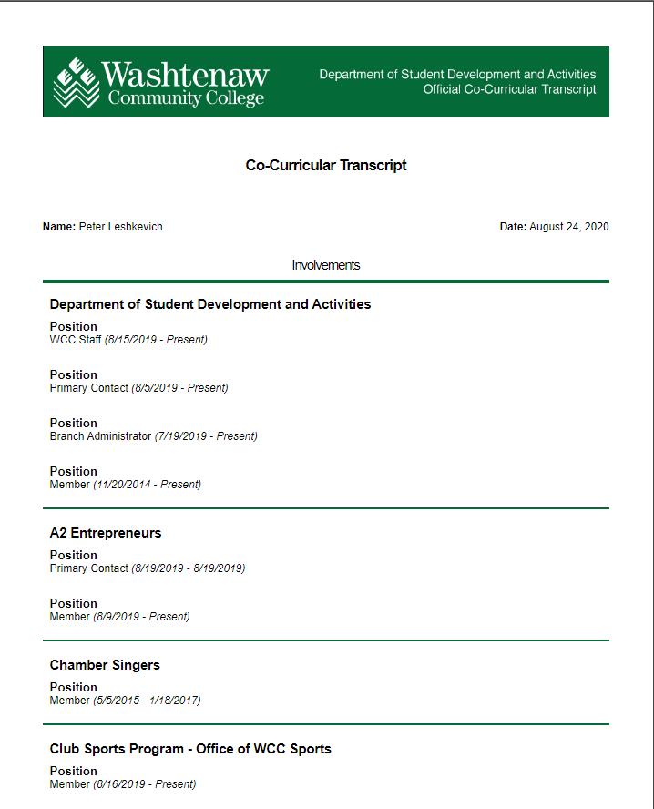
Record Your Involvement!
As you progress through your pathway and get involved in student life, our Campus Connect system will record your participation!
To Login to Campus Connect:
Visit: https://campusconnect.wccnet.edu

Slide 13
Student Activities – rbarsch@wccnet.edu Student Organizations – vboissoneau@wccnet.edu WCC Sports – mflucas@wccnet.edu Washtenaw Voice – jumcgovern@wccnet.edu Phi Theta Kappa – vboissoneau@wccnet.edu
VISIT US ONLINE AT:
https://campusconnect.wccnet.edu
TO GET INVOLVED IN STUDENT LIFE – EMAIL:

