Slide 1
Goal Setting & Tracking
Discover the strategies for setting effective Goals

Slide 2
This presentation will discuss
The purpose of goal-setting
Types of goals:
Long-term
Short-term
How to create effective goals
“DREAM” goals
“SMART” goals
How to track progress

Slide 3
Why do I need To set goals?

Slide 4
You are going places!
Notes:
Everyone is progressing toward a future
Consciously or unconsciously you are making choices
Knowing about the different types of goals (Short & Long-Term) helps you get there.
-Let’s use the analogy of taking a journey

Slide 5
Goal-Setting Clarifies Context
Short-Term Goals
Long-Term Goals
Notes:
When the context is clear, people generally are able to make better choices.
Long-term goals (on the right, in the image): The destination or path
Keep us motivated
Provide a direction
Short-term goals (on the left, in the image): The steps to get there
Keeps us productive
Provides a focus

Slide 6
Notes:
Let’s go over how to set goals that are more likely to help you be successful
Long-term goals: Use “DREAM” goals acronym
Short-term goals: Use “SMART” goals acronym
Remember: the two types of goals need to connect with each other to be effective.

Slide 7
“DREAM” Goals: Where will you be in five or ten years?
Notes:
Long-term goals are about your dreams

Slide 8
D
Distant
R
Radical
E
Enthusiasm
A
M
Attitude
Method-Based
Notes:
Distant: Future ambitions & aspirations
Radical: may seem unreal or impossible to others to imagine; you dare to dream about a future self
Enthusiasm: Have strong positive feelings & beliefs toward it; eagerness
Attitude: Embrace a growth mindset or a frame of mind that makes this possible
Method-based: Find a system that helps you develop through practice.

Slide 9
Examples:
“I want to become an Accountant”
“I want to travel to Mars”
Distant | ✓
Radical | ✓
Enthusiasm | ✓
Attitude | ✓
Method-based | ✓
Distant | ✓
Radical | ✓
Enthusiasm | ✓
Attitude | ✓
Method-based | ✗
Notes:
In the first dream goal, the individual could have all kinds of perceived barriers:
Not so good at math or reading
Don’t know how to pay for grad school
Don’t have a lot of experience
Self-doubt
The second dream-goal is admittedly fantastic. The point of this example is to show how much a practice impacts setting & achieving any goal.

Slide 10
YOU TRY IT: Create a DREAM Goal
Go to Page 3 of the Tracking Document
Create your own DREAM Goal
Write it into the document
Notes:
It doesn’t have to be perfect
Take 30 seconds and come up with 1-2 ideas “just for now”
You can change your mind later.

Slide 11
“SMART” Goals: How will you get there?
Notes:
Short-Term goals are about working smart
A SMART goal is a tool used as a guide to help with short-term goal setting.
It helps to clarify your ideas, focus your efforts, use your time and resources productively, and increase your chances of achieving what you want in life

Slide 12
S
Specific
M
Measurable
A
Attainable
R
T
Time-Bound
Relevant
Notes:
The SMART Acronym stands for:
Specific: Explains exactly what you will do
Measurable: Uses external factors to show progress
Attainable: It needs to be realistic
Relevant: It needs to be related to the life and person you are today
Time bound: It needs to be completed by a specific deadline

Slide 13
Examples:
“I will practice all the tricky math problems in this section three times before the quiz on Tuesday.”
“I want to keep up in my Math class”
Specific | ✓
Measurable | ✓
Attainable | ✓
Relevant | ✓
Time-Bound | ✓
Specific | x
Measurable | x
Attainable | ✓
Relevant | ✓
Time-Bound | x
Notes:
In the first smart goal, the individual has a goal that meets all the criteria:
Specific: focusing on the challenging problems
Measurable: getting right answer
Attainable: can do the problem 3 times
Relevant: points to a specific section
Time-Bound: Tuesday
The second short-term goal is less well-defined. It is not a SMART goal.
Non-specific: what does “keeping up” mean?
Measurable: how will you know if you have kept up?
Attainable: seems possible but don’t know how
Relevant: related to the class
No Timeline: When will be know if we are hitting or missing the target?

Slide 14
YOU TRY IT: Create a SMART Goal
Go to Page 2 of the Tracking Document
Create your own SMART Goal
Write it into the document

Slide 15
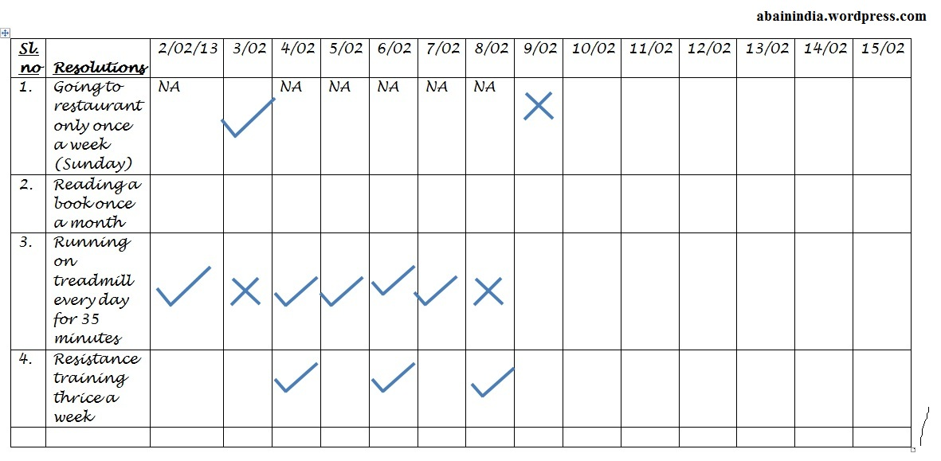
Tracking sheets
Notes:
Finally, use a daily tracking sheet to help you remind you of SMART goals & see progress.
We have provided some tracking sheet to help you with these goal settings.

Slide 16
Ex: Daily Habits
Checking WCC Email
Checking Blackboard
Checking Course Calendars
Completing Weekly Reading
Attempting All Homework Assignments
Asking for Help
Attending All Classes
Answering one question in class everyday
Meeting one new classmate everyday
Taking notes in class, even if they are provided
Reviewing notes
Creating a Study Guide
Track your common mistakes
Notes:
Here are examples of things that might be good daily habits to track.
These could inspire you to develop a short & long-term goals.

Slide 17
Upcoming Events
Effective Reading Strategies
Note-Taking
Test-Taking
Ineffective Study Habits
Project Planning
Organizing Student Email
DIY Study Guide
Notes:
The learning commons has Skill Building Workshops every week. I invite you to check the calendar on the website and stop by.

Slide 18
Our Services
Study Help
Drop-In Study Help for all courses
Study Groups
On-Track Appointments
Question Drop-Off
Tech Help
Drop-In Student Tech Help
Ask-a-Lab Associate Question Drop-off
Get Tech Ready and Appy Hour Workshops
Learning Help
Check out our collection of self-service resources that supplement classroom materials
Get In Touch!
www.wccnet.edu/LC (live chat assistance offered during regular hours)
(734) 973-3420
Lab Email: LCLab@wccnet.edu
Tutoring Email: TutorWCC@wccnet.edu

