Slide 1
LEARNING ONLINE
Welcome to

Slide 2
Do’s and Don'ts of Online Learning
Video on if bandwidth permits
Mute if not talking
Dress appropriately
Use backgrounds to keep private spaces private
Eating? Depends on the instructor and situation
This Photo by Unknown Author is licensed under CC BY-SA

Slide 3
Best practices for being a student still apply to online environment!
Take notes
Gather supplies like pen and notebook before class.
Ask questions
Do instructors want questions in chat or verbally?
Come to class prepared
Write down questions while you complete assignments and readings.
Read & Print your syllabus
This is your roadmap to success!

Slide 4
Build a Shared Learning Team
Connect with other students
Blackboard
Email
CircleIn
Share notes
Ask and answer questions
Host virtual study sessions
Win prizes!
Learning Commons Resources
Study Groups
Offered for many classes
Form the first few weeks of class and meet all semester
Drop-in Study Help
Math tutors support every math problem on campus
General tutors support every class on campus
Notes:
Blackboard
Email other students
Ask for a study buddy
CircleIn
Peer to peer study app that allows you to:
Share notes
Ask and answer questions
Host virtual study sessions
Win prizes
Study Groups and Drop-in Study Help are live links that you can click on to get to these resources.

Slide 5
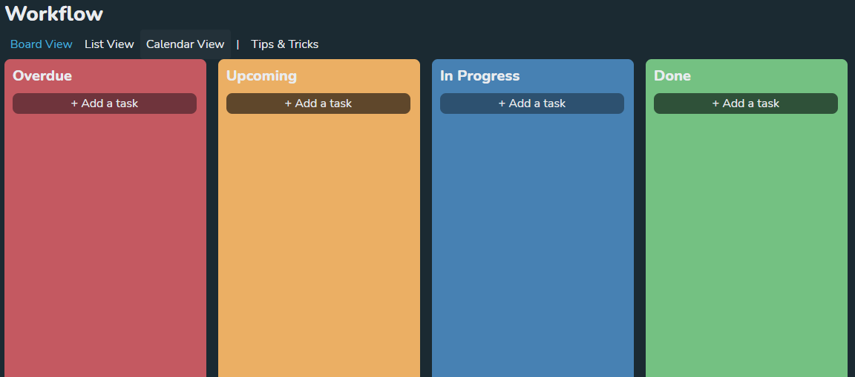
Managing the Stresses of Online Learning
Create a plan:
Learning Commons Workshops
Go to: wccnet.edu/LC
Submit assignments early
Technology problems are not an excuse for late assignments.
CircleIn
Flashcards
Workflow
Notes
Be Organized
We have a workshop for that!
GET YOUR DUCKS IN A ROW!!!
Notes:
The Learning Commons short workshops will help you get your technology set-up and teach you all those helpful skills that everyone expects college students to know, but no one every teaches you.

Slide 6
Managing the Stresses of Online Learning
Know your resources
Who is available to help?
How do you connect with instructor?
Check your WCC email regularly.
Student Resource Center
WCC Counselors, Advisors, and Success Coaches
LinkedIn Learning
Notes:
At WCC you don’t have to go it alone!
Student Resource Center helps with:
Navigating the college system
Paying for childcare
Getting emergency food or financial assistance
Financial aid and grants
Managing personal issues
WCC Counselors, Advisors and Success Coaches help with:
Exploring career options
Plan your degree – at WCC and beyond
Focus in goal-setting and academic success
LinkedIn Learning
Free to all students
Supplement your classroom experience with a video library of engaging, top-quality mini-courses taught by recognized industry experts.

Slide 7
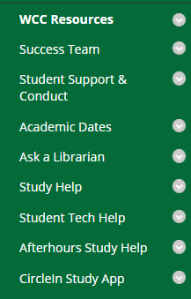
Blackboard Hacks
Discussion boards
Post early and ask the Learning Commons Lab Associates for help
Don’t copy and paste from word documents. Upload images separately.
Manage Assignments
Save assignments in a central location on your computer so they are easy to find when you need to submit them.
Save all Emails that come from Blackboard system. i.e. assignment submissions
Do not delete copy of submission after you submit it.
Get familiar with each course. Not all classes are set up the same.
Notes:
In Blackboard you have direct access to the academic support you are most likely to need.
Ask A Librarian
Chat system available 24/7
Get support with all your research and copyright questions!
Study Help
Goes to the Learning Commons website where you will find a variety of academic programs that support every class on campus!
Student Tech Help
Provides you with a variety of live and self-service resources for all your technology questions.
Afterhours Study Help
Any time we don’t have a live WCC tutor available you can access free online tutoring through Afterhours Study Help.
Available 24/7
CircleIn
we’ve already talked about
If you want to get set-up on CircleIn and see an overview of what we do come to a Learning Commons CircleIn workshop which will be the first 3 weeks of class!

Slide 8
How to connect with your instructor
Read syllabus for office hours and preferred ways to connect
Introduce yourself at the beginning of the semester!
Visit your instructor during office hours - they can’t wait to see you!
Email through Blackboard to ensure correct email address.
Instructors typically respond within 48 business hours – but often much more quickly!
Be professional when emailing
Use greeting, be polite, punctuation and full sentences are expected
State problem clearly
Use screenshots, if needed

Slide 9
Connect with the Learning Commons
wccnet.edu/LC
LCLab@wccnet.edu
734.973.3420
Notes:
Our Winter 2021 schedules are on the next four slides. We hope that you’ll review them when you receive this presentation.

Slide 10
Drop-In Study Help
Humanities, Social Sciences & Arts
Winter 2021 wccnet.edu/LC
General Studies
General Studies tutors are trained in study skills and academic strategies to support students in all disciplines.
Workshops
1pm – 5pm
6pm – 8pm
Don’t Stress that Test Workshops:
DIY Study Guide
General Test Taking Tips
Mindset Workshops:
Growth Mindset
Motivation Clinic
Communicating with Instructors
Plan Like a Boss Workshops:
Get Organized
Goal Setting & Tracking
Study-O-Gram
Planning Projects
Time Savers Workshops:
How to Study
Notetaking Strategies
Memorization Strategies
2pm – 5pm
6pm – 8pm
Study Groups
ACS 107
ACS 108
ANT 201
COM 101
Visit the Learning Commons website to request a Study Group for classes not listed. Study Groups need three students to run.
Afterhours Study Help is available 24/7 for disciplines not listed.
*
Thursday Wednesday Tuesday Monday
*
11am-12pm
1pm – 2pm
4pm – 6pm
*
11am – 12pm
3pm – 4pm
Visit wccnet.edu/LC for details!
Washtenaw Community College does not discriminate on the basis of religion, race, color, national origin, age, sex, height, weight, marital status, disability, veteran status, sexual orientation, gender identity, gender expression, or any other protected status in its programs and activities. The following office has been designated to handle inquiries regarding non-discrimination policies, Title IX or ADA/504 inquires: Vice President of Student & Academic Services, SC 247, 734-973-3536.

Slide 11
Drop-In Study Help
Math, Business & Technical Foundations
Winter 2021 wccnet.edu/LC
We help with every math problem on campus!
Mathematics
Statistics
Computer & Web
Programming
Workshops
3pm to 6pm
Calculator Workshops:
Calculator Basics
Advanced Calculator Functions
Statistics on Your Calculator
Tackle the Math Workshops:
Why Does Order Matter?
4 out of 3 People Struggle with Math
Probably Probability
Do You Know the Line?
Beating the System (of Equations)
Study Groups
MTH 094
MTH 097
MTH 125
MTH 160
MTH 176
CPS 161
CPS 171
Visit the Learning Commons website to request a Study Group for classes not listed. Study Groups need three students to run.
Visit wccnet.edu/LC for details!
10am to 4pm
5pm to 8pm
11am to 8pm
2pm to 8pm
Thursday Wednesday Tuesday Monday Sunday
12pm to 3pm
10am to 2pm
3pm to 5pm
10am to 2pm
3pm to 5pm
3pm to 6pm
Afterhours Study Help is available 24/7 for disciplines not listed.
Washtenaw Community College does not discriminate on the basis of religion, race, color, national origin, age, sex, height, weight, marital status, disability, veteran status, sexual orientation, gender identity, gender expression, or any other protected status in its programs and activities. The following office has been designated to handle inquiries regarding non-discrimination policies, Title IX or ADA/504 inquires: Vice President of Student & Academic Services, SC 247, 734-973-3536.

Slide 12
Drop-In Study Help
Science, Health & Public Service Careers
Winter 2021 wccnet.edu/LC
Biology
Behavioral
Sciences
Chemistry
Health
Sciences
Physics
Workshops
11am – 2pm
2pm – 5pm
11am – 2pm
Science Meets Math Workshops:
Using your TI-30Xa Calculator in Chem Class
Combining Biology and Statistics
Mastering Dosing Calculations
Health Workshops:
Conquer the TEAS
Study Groups
CEM 111
BIO 101
PHY 111
PSY 100
Visit the Learning Commons website to request a Study Group for classes not listed. Study Groups need three students to run.
Visit wccnet.edu/LC for details!
Afterhours Study Help is available 24/7 for disciplines not listed.
10am – 2pm
3pm – 6pm
2pm – 5pm
2pm – 5pm
Thursday Wednesday Tuesday Monday Sunday
10am – 1pm
3pm – 6pm
12pm – 3pm
Washtenaw Community College does not discriminate on the basis of religion, race, color, national origin, age, sex, height, weight, marital status, disability, veteran status, sexual orientation, gender identity, gender expression, or any other protected status in its programs and activities. The following office has been designated to handle inquiries regarding non-discrimination policies, Title IX or ADA/504 inquires: Vice President of Student & Academic Services, SC 247, 734-973-3536.

Slide 13
LC Lab Hours Available by chat, phone, email
Student Tech Help
Winter 2021 wccnet.edu/LC
Drop-In Tech Help
Lab Hours
12:00pm – 6:00pm
Lab Hours
Lab Associates are available by:
Chat: wccnet.edu/LC
Phone: 734.973.3420
Email: LCLab@wccnet.edu
Workshops
Get Tech Ready
Blackboard Basics
Microsoft Office 365
CircleIn
Zoom
Make Technology Work for You
Tame the Email Beast
Exploring WCC Online Learning Resources
Microsoft Accessibility Features
Microsoft Word: Citation Manager
Organize Your Drive
Appy Hour:
Duolingo
2:00pm – 4:00pm
8:00pm – 9:30pm
7:30am – 10:00pm
9:00am – 11:00am
8:00pm – 9:30pm
7:30am – 10:00pm
Student Tech Help
Attend a Drop-In Student Tech Help session or schedule a Lab Consultation for one-on-one help.
Lab Associates can assist with:
Blackboard
CircleIn
Microsoft Office
Gmail
Zoom
Saturday Friday Thursday Wednesday Tuesday Monday Sunday
1:00pm – 3:00pm
7:30am – 10:00pm
9:00am – 11:00am
4:00pm – 5:00pm
7:30am – 10:00pm
10:00am – 12:00pm
7:30am – 5:00pm
4:00pm – 5:00pm
12:00pm – 6:00pm
Visit wccnet.edu/LC for details!
Washtenaw Community College does not discriminate on the basis of religion, race, color, national origin, age, sex, height, weight, marital status, disability, veteran status, sexual orientation, gender identity, gender expression, or any other protected status in its programs and activities. The following office has been designated to handle inquiries regarding non-discrimination policies, Title IX or ADA/504 inquires: Vice President of Student & Academic Services, SC 247, 734-973-3536.

