Slide 1
Providing Stellar Service
Sally Schmall, MSW, SPHR Organizational Development Manager

Slide 2
You are the customer
Share your most memorable customer service experience over the past month.
  Outstanding Customer Service Situation: (adjectives)
  Unsatisfactory Customer Service: (adjectives)
  What are the common experiences from both positive and negative situations?

Slide 3
Why does customer service at WCC matter?
Customer service expectations from students continue to increase, and it is critical to meet that demand with a strong commitment to developing a culture of service.

Slide 4
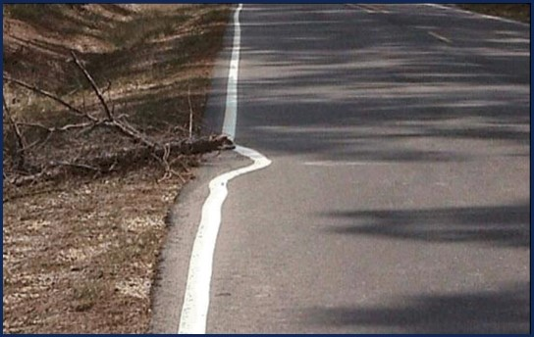
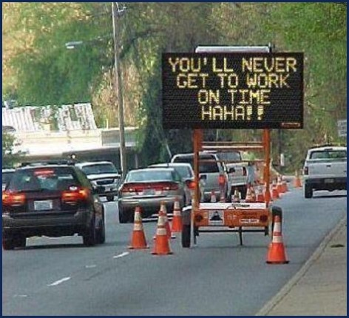
This is not stellar customer service….

Slide 5
What is stellar customer service ?
What word best describes stellar customer service?
Give an example of stellar service within your area.
Notes:
In pairs of two

Slide 6
Customer Service Report Card
When asked to describe how they define stellar customer service, overwhelmingly, the respondents focused on responsiveness.
  eliminating wait times, shortening lines, and ensuring that students receive the help they want and need

Slide 7
Customer service report card
79 institutions about customer service
29 respondents rated their institution with a “B” letter grade for customer service
31 would assign a “C” grade (together accounting for three-quarters of the total responses).
Only six would assign an “A.”
What grade would you assign your area?

Slide 8
Identifying the challenges
“We need a cultural shift; our faculty/staff don’t see customer service as necessary.”
“We aren’t sure how to audit our current service and identify bottlenecks/gaps.”
“We don’t provide effective customer service training.”

Slide 9
Culture shift
“We need to stop thinking about service to the student as an interruption to our work. Service to the student is why we’re there. Your #1 priority is taking care of the student. Drill that in.”
  Rick Weems, Southern Oregon U

Slide 10
Culture shift
Striving for first-contact resolution.
  The commitment that in as many cases as possible, the student’s inquiry or obstacle will be addressed during their first contact.
  If the staff member who answers the phone, receives the student’s email, or speaks to the student is unable to resolve the issue, they should be able to refer the student immediately to the correct person who can.

Slide 11
Culture shift
We hold a "Development Day" where presentations are made by different departments about what that department does & how their responsibilities & actions affect other departments. Having awareness of the "big picture" helps everyone provide better assistance to our students and remind us "why we're here."
  Mary Briody, Assistant Director of Bursar Operations, Dowling College

Slide 12
Addressing structural barriers
Structural barriers occur whenever the process for a student to get from Point A to Point D creates “runaround” for the student.
Runaround is not only students’ biggest service-related complaint; it is a serious service issue that detracts from students’ time and attention to their studies.
Notes:
Often, the barriers are structural, not just philosophical.

Slide 13
Addressing structural barriers
Students are asked to rate (on a 1-5 Likert scale, with 1 being the lowest rating and 5 the highest) both the importance of a service to their ability to register for, attend, and succeed in their classes, and how well the institution is providing that service to them.
The survey is designed to identify the most important gaps in service and assists in prioritizing efforts to improve services.

Slide 14
Where are the bottlenecks?
Lay a rope out over the floor, using it to simulate the path a student takes from admission to sitting in the classroom.
Points along the rope can represent particular steps.
Often there is disagreement among the staff on the sequence of steps. Surfacing these disagreements together can help you identify where in the process students may be left confused or misdirected.

Slide 15
Where are the bottlenecks?
Interview a student who recently navigated the process. Interview a first-generation student. Where did they find delays?

Slide 16
Training and time
During onboarding, it is critical that new staff meet the right people and get walked through the processes from the student’s perspective.
Provide cross-training.
  Incoming student inquiries are likely to be questions related to financial aid.
  The more that front-line staff across enrollment services can understand and answer basic financial aid questions the better equipped you will be to provide stellar service

Slide 17
Training and time
Dedicate consistent, weekly time (30 minutes) to ensure that service-oriented training is an ongoing rather than a “one-off” effort.
Create customer friendly email templates to address the most common questions sent in by students.
Notes:
Often times, students just want to be heard. Once they feel that they have that accomplished, it becomes easier to solve their problem.

Slide 18
Customer service tips
View the student as a customer - - without them, there would be no job.
When a student is experiencing a problem, it is important to first address the human side of the problem before tackling the business side.
Follow up is king!

