Slide 1
Speaking to Influence Others
Sally Schmall, MSW, SPHR Organizational Development Manager
sschmall@wccnet.edu

Slide 2
“A lie can get halfway around the world before the truth can even get it’s boots on” - Mark Twain

Slide 3
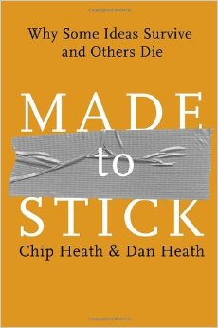
Made to Stick

Slide 4
The Curse of Knowledge
Once we know something, we find it hard to imagine what it is like not to know it.
Information imbalance is a common occurrence.
Tappers and listeners are managers and employees, professors and students, parents and children…….

Slide 5
Six Principles of Sticky Ideas
Simplicity
Unexpectedness
Concreteness
Credibility
Emotions
Stories

Slide 6
SUCCESs
Checklist | Message
Simple
Unexpected
Concrete
Credible
Emotional
Story

Slide 7

Finding the core at Southwest Airlines
Southwest has been consistently profitable for more then 30 years
Herb Keller “I can teach you the secret to running this airline in thirty seconds. This is it: We are THE low-fare airline. Once you understand that fact, you can make any decision about this company’s future as well as I can.”
Have fun at work – employees can put new ideas together to impact customer service

Slide 8
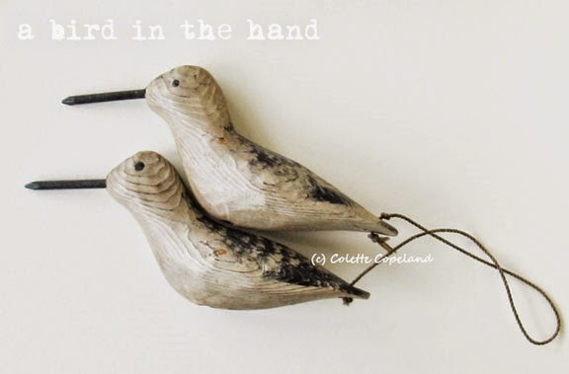
Simple = Core + Compact

Slide 9
What’s the Golden Rule?
“Do unto others as you would have them do unto you”
Ideas that are compact enough to be catchy and meaningful enough to make a difference are remembered
Compactness is essential – otherwise information overload.
How can you make your messages more simple (core + compact)?

Slide 10
Unexpected
Flight safety announcements occur in a tough message environment.
What if you had to make the safety announcement? How would you get people to listen to you?
https://www.youtube.com/watch?v=lz_qsExV6dQ

Slide 11
Unexpected
Most of the time we can’t demand attention, we must attract it.
Break a pattern
We can’t influence others if our messages don’t break through the clutter to get attention
  How do you get people’s attention?
  How do you keep it?

Slide 12
Unexpected
Surprise
Interest keeps our attention
  Identify the core of your message
  Figure out what is counter intuitive about it (i.e. unexpected implications of your core message)
  Communicate message in a way that creates surprise and interest
Notes:
Surprise jolts us to attention
Interest motivates us to pay attention
Cant be gimmiky, it has to stick to your core message but deliver it in a way people don’t expect and that leaves them with more insight

Slide 13
Concrete
What makes something concrete?
  If you can examine or experience something with your senses, it’s concrete.
  Concrete ideas are easer to understand and remember.
  Concreteness makes targets transparent.
  “High performance” is abstract.
  “Great customer service” is abstract.
  “Participation in class” is abstract.

Slide 14
Concrete
Step 1: Write down as many things that are white in color as you can think of in the next fifteen seconds.
Step 2: Write down as many white things in your refrigerator as you can think of.
Concreteness is a way of mobilizing and focusing your brain.
Notes:
One step at a time
Most people can list about as many white things in their fridge as white anything's in the world.
Why does this happen?
Third bullet: Concreteness is a way of mobilizing and focusing your brain.

Slide 15
Concrete
It takes effort to speak concretely about a subject / task you know well.
It is easy to loose awareness that we are talking like an expert (Curse of Knowledge).
Effort in being concrete increases likelihood that other will understand.

Slide 16
Credible
For a long time, the cause of ulcers was a mystery.
Ulcers are caused by bacteria (H.pylori)
If ulcers were caused by bacteria, they could be cured by antibiotics!
Improve the health and comfort of
several hundred million people.
Unfortunately, no one believed them.

Slide 17
Credible
Scientist had believed other theories for so long that they would not shift their perspective
Warren was a staff pathologist and Marshall was a resident.
The medical community expects important discoveries to come from world class research Universities not Perth.
Notes:
There were several reasons why they weren’t believed.
Marshall and Warren could not even get their research paper accepted by a medical journal.

Slide 18
Credible
1984 Marshall drank a glass filled with a billion H.plori “It tasted like swamp water”
Experiencing pain, nausea and vomiting
Cured himself with antibiotics – spurred subsequent research
1994 the NIH endorsed the idea that antibiotics were the preferred treatment for ulcers
2005 Marshall & Warren received the Nobel Prize in Medicine

Slide 19
Finding Credibility
What makes people believe ideas?
Tap into:
  Authorities / experts (Stephen Hawking)
  Celebrities (Oprah book club)
  Anti-authorities: someone who does not have a vested interest
    The honesty and trustworthiness of our sources, not their status, allows them to act as authorities
    Who are the anti-authorities that you should tap into to convey your message?

Slide 20
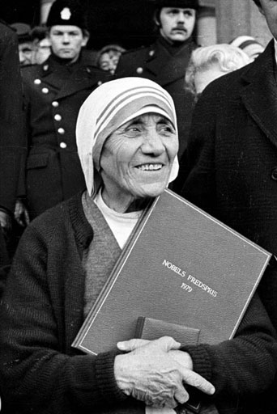
Emotional
“If I look at the mass, I will never act.” If I loo at one, I will”. Mother Theresa

Slide 21
Emotional
Offered participants $5 to complete a survey
When survey was completed participants’ were given a charity request letter
Two versions (statistics/story)
Statistics version - $1.14 the story version $2.38
Avoid the “drop in the bucket affect”

Slide 22
Emotional
What matters to people?
  People matter to themselves
  Invoke self – interest “WHIFF-Y”
  Invoke group interest – why would this matter to the group?
  Ask yourself the “three whys”

Slide 23
Stories
Stories are an effective teaching tool if they provide knowledge and motivation
1990’s Subway launched a campaign to tout the healthiness of a new line of subs.
Based on a statistic: 7 subs under 6 grams of fat. “7 Under 6”

Slide 24
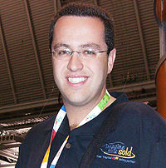
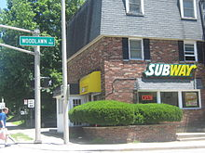
Stories: The Subway Diet
Jared Fogle
The Bloomington Subway

Slide 25
Stories
The first spot aired on January 1, 2000, introducing Fogle and his story, complete with a disclaimer:
"The Subway diet, combined with a lot of walking, worked for Jared. We're not saying this is for everyone. You should check with your doctor before starting any diet program. But it worked for Jared."

Slide 26
SUCCESs
It’s simple. Eat subs lose weight
It’s unexpected: Loose weight eating fast food?
It’s concrete: Formula – eat only subs
It’s credible: Antiauthority truthfulness
It’s emotional: It is about Jared
It’s a story: He overcomes the odds and we can too!

